Slide 1
LinfiShot
“CLI Linux tool to see if sketchy programs do sketchy things to important files”
By Andrew Steiner and Priya Gopani

Slide 2
The Problem.
You download a sketch program
But want to run it anyways
Need a quick way to check if it modifies anything maliciously
Want some visuals
Notes:
Andrew

Slide 3
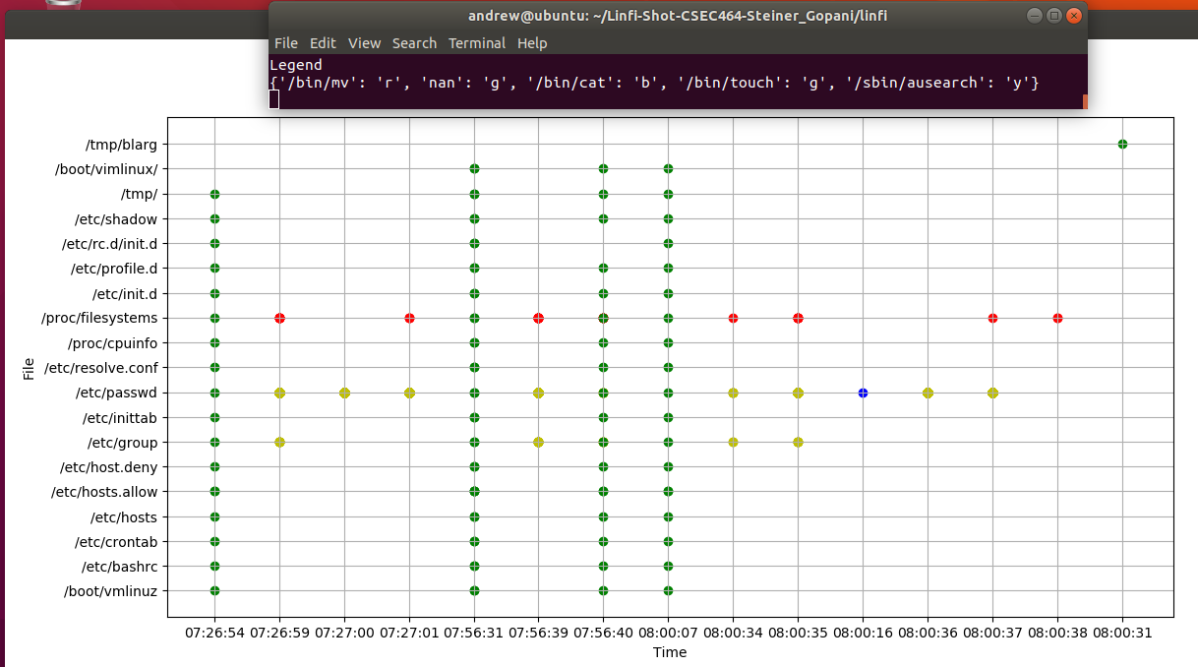
What is LinfiShot ?
Linux CLI tool
Spots attempted or successful important file changes
Displays an analysis on file change
Filename, timestamp, program/executable, syscall, status
Generates a report and graph visual of the results
Easily add it to a forensics toolkit
Notes:
Priya
Linfishot is a CLI based tool, that can be used see if a program or exe caused any changes to Linux most important files. That is crucial to know becuase in Linux anything can be accessed through its filesystem.

Slide 4

audit
auditctl - command line interface for auditd
ausearch - search through audit logs
aureport - provide reports from ausearch output
Notes:
Andrew

Slide 5
Target Audience
Investigators
Researchers
Everyone
Notes:
priya

Slide 6

Demo

Slide 7
Moving Forward - Improvements
Add frontend GUI
Add and fix Legend
Customizability
Notes:
andrew

Slide 8
Lessons Learned
ELK is NOT ALWAYS great to manage logs
Tools for toolkits should be low dependency
Python has great libraries - numpy and matplotlib
Auditd is amazing !
Notes:
priya

Slide 9
Thank You & Questions

